Slide 1
SMART HOME AUTOMATION
WATSON ASSISTANCE SERVICE
TEAM: CODE_TRACKERS

Slide 2
INTRODUCTION TO SMART HOME AUTOMATION
A home automation system will control lighting, climate, entertainment systems, and appliances. It may also include home security such as access control and alarm systems
Automation is an efficient method to use in every field such that to reduce manpower, energy usage and also for improving the quality and efficiency of any system

Slide 3
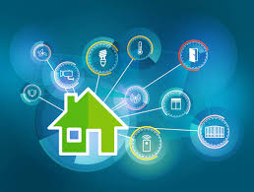
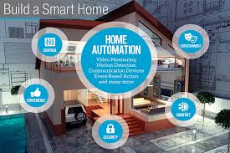

Slide 4
BLOCK DIAGRAM
POWER ON
NODE RED UI:
USER: POWER ON
BOT:POWER IS ON
IBM CLOUD
NODE MCU
(MICROCONTROLLER)
POWER OFF

Slide 5
NODE RED
Node-RED is a flow-based development tool for visual programming developed originally by IBM for wiring together hardware devices, APIs and online services as part of the Internet of Things. Node-RED provides a web browser-based flow editor, which can be used to create JavaScript functions.

Slide 6
IBM CLOUD
IBM cloud computing is a set of cloud-computing services for business offered by the information technology company IBM. It includes infrastructure as a service (IaaS),software as a service (SaaS) and platform as a service (PaaS) offered through public, private and hybrid cloud delivery models, in addition to the components that make up those clouds.

Slide 7
NODE-MCU
NODE-MCU is an open source IOT platform.
It includes firmware which runs on the ESP8266 Wi-Fi SoC from Espressif systems, and hardware which is based on the ESP-12 module.

Slide 8
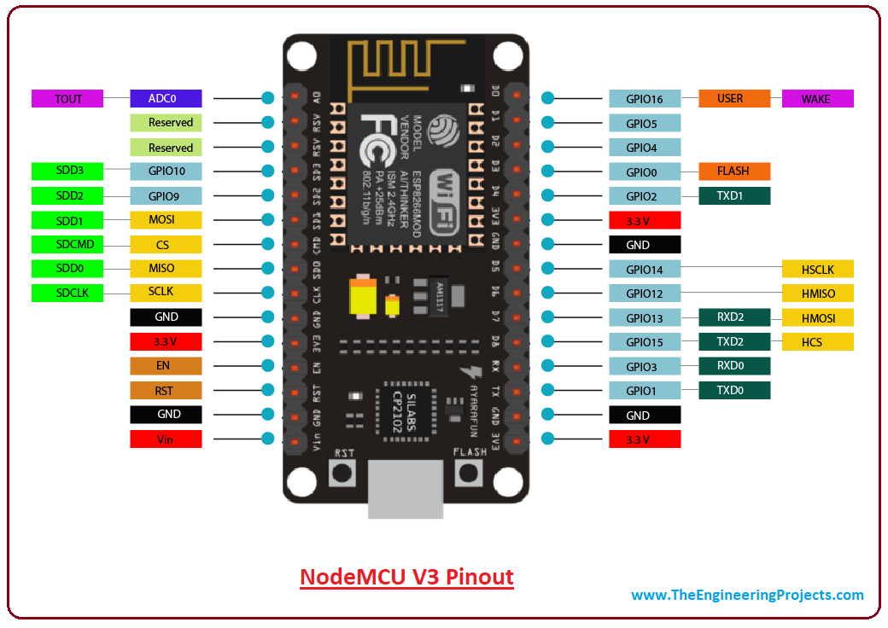

Slide 9
ARDUINO IDE
The Arduino-IDE integrated development environment (IDE) is a platform application that is written in the programming language Java. It is used to write and upload programs to Arduino compatible boards, but also, with the help of 3rd party cores, other vendor development boards.

Slide 10
WATSON SERVICES
Watson uses IBM's software. The system was written in various languages, including Java, C++, and runs on the SUSE Linux Enterprise Services 11 operating system to provide distributed computing.

Slide 11
ADVANTAGES
Safety. The ability to control small appliances and lighting with your fingertips anywhere you are will add safety in your home. You can make sure appliances are off when its needed to be off and on when its needed to be on.
Security. The ability to lock the door through your phone is one of the greatest benefits of home automation. This will give you peace of mind knowing that the door is close and not guessing. The fact that you can be alerted each time someone enters your home also allows you to monitor who is entering your home at all times, especially when you are not there.

Slide 12
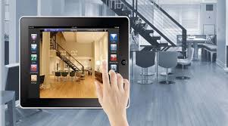
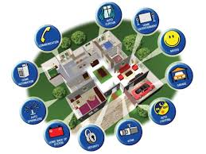

Slide 13
Convenience. The ability to control everything with your fingertips is very convenient. You never leave the house without your wallet, keys and your smart phone. With our smart phone always with us, we can easily monitor our home and control everything with just touch of a finger.
Saves Time. Since we are living in a very fast-paced environment, we don’t even have time to worry about our home. With home automation, we can save time going back to our home and make sure everything is order, like if the kids close the door from school or turn on the lights when you get home.
Save Money. This is the biggest advantage of home automation. With the ability to control the light, whether dimming or turning on/off on specific time will saves homeowner a great ton of money. You can save money through household temperature, with proper automation in window shades and automated thermostat. In addition, you can save gas, by not driving back home if you forgot to turn off appliances or lock the door.

Slide 14
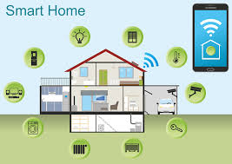
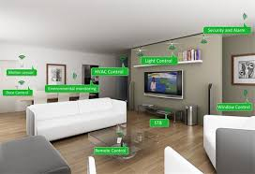

Slide 15
APPLICATIONS:
Lighting Control: Leaving the Dark Ages and Stepping Into the Light.
Lawn Irrigation Systems: The Grass is Always Greener.
kitchen appliances
Home whether automation
Security management

Slide 16
THANK YOU
DONE BY: #CODE_TRACKERS
187Y1A0449
187Y1A04A5
187Y1A04E3

